Slide 1
Hotel management database system
Shivangi bhagurkar

Slide 2

Index:
Introduction
ER Diagram
Tables
joins
Subqueries

Slide 3
Introduction
The Hotel Management System is a database project designed to streamline and organize hotel operations. It focuses on managing essential entities such as Guests, Bookings, Staff, and Departments, ensuring smooth coordination and efficient data handling.
By using MySQL with joins and subqueries, this project demonstrates how relational databases can:
Maintain guest details and booking records,
Track staff information and their assigned departments,
Link multiple tables to generate meaningful insights,
Simplify hotel operations through structured data retrieval.

Slide 4
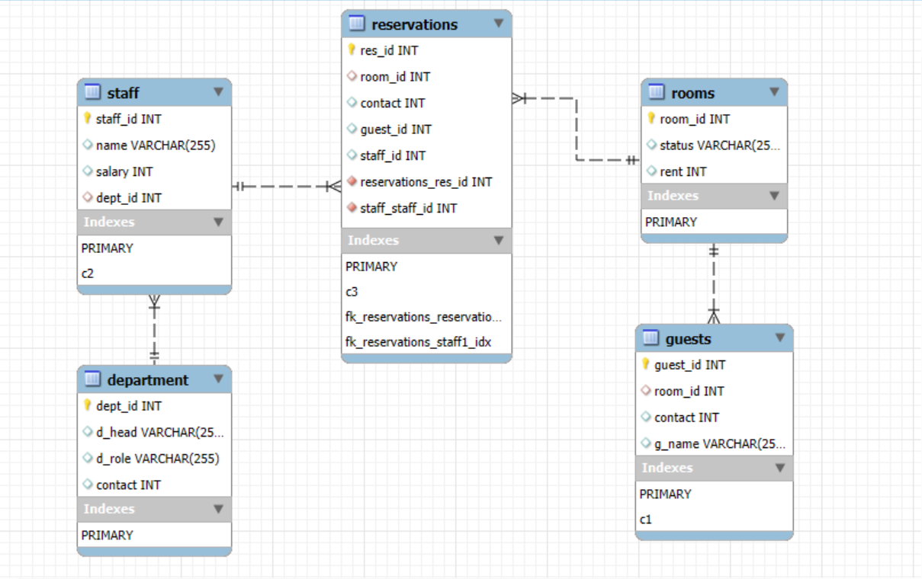
Er diagram
Tables:
Guests: store guest details.
Reservations: Records of reservations made by guests.
Staff: Maintains employee information.
Departments: Categorizes staff into different functional areas

Slide 5
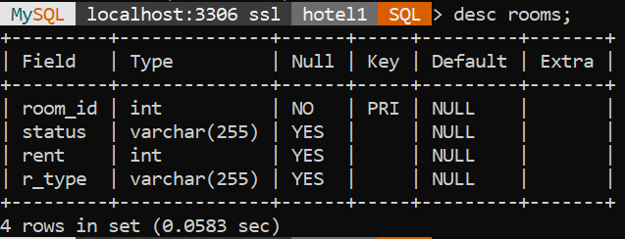
structures: rooms
Syntax:
Desc rooms ;

Slide 6
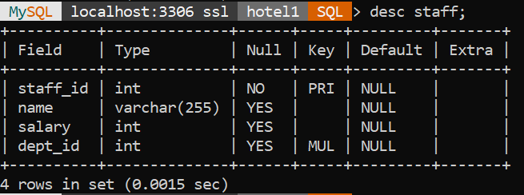
structures: staff
Syntax:
desc staff ;

Slide 7
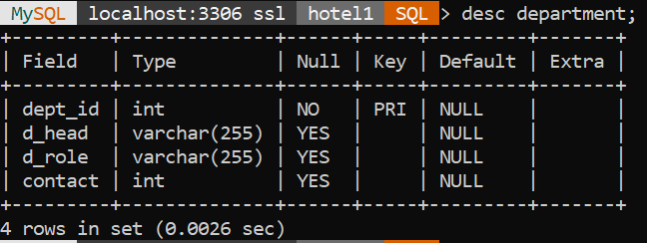
structures: department
Syntax:
desc department ;

Slide 8
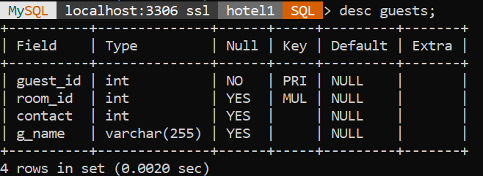
structures: guests
Syntax:
desc guests ;

Slide 9
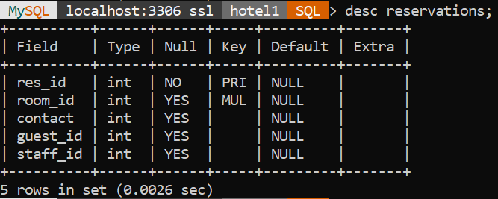
structures: reservations
Syntax:
desc reservations ;

Slide 10
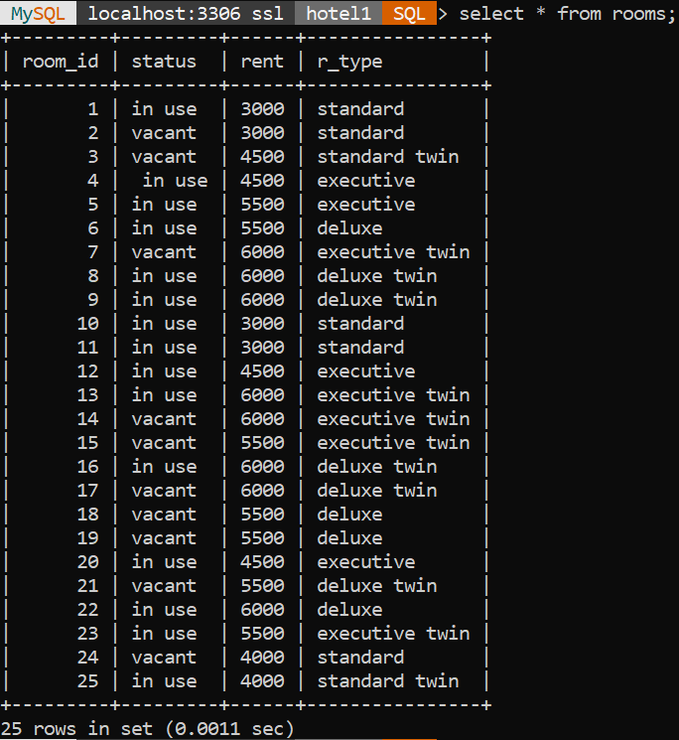
contents:
Rooms table
create table rooms (
room_id int primary key,
status varchar(255),
rent int
r_type varchar(255)
);

Slide 11
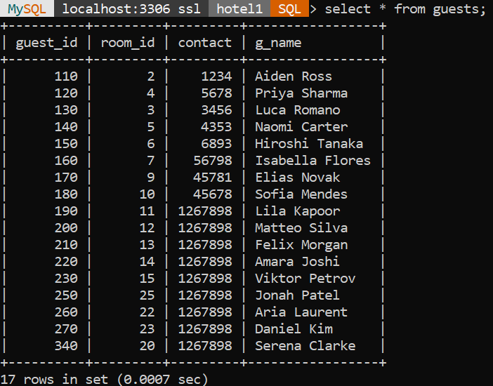
contents:
Guests table
create table guests (
guest_id int primary key,
room_id int,
contact int
g_name varchar(255)
);

Slide 12
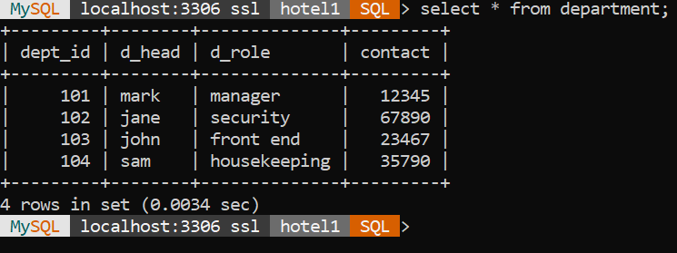
contents:
Department table
create table department (
dept_id int primary key,
d_head varchar(255),
d_role varchar(255),
contact int
);

Slide 13
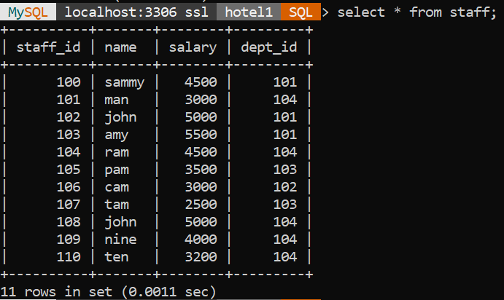
contents:
Staff table
create table staff (
staff_id int primary key,
name varchar(255),
salary int,
dept_id int);

Slide 14
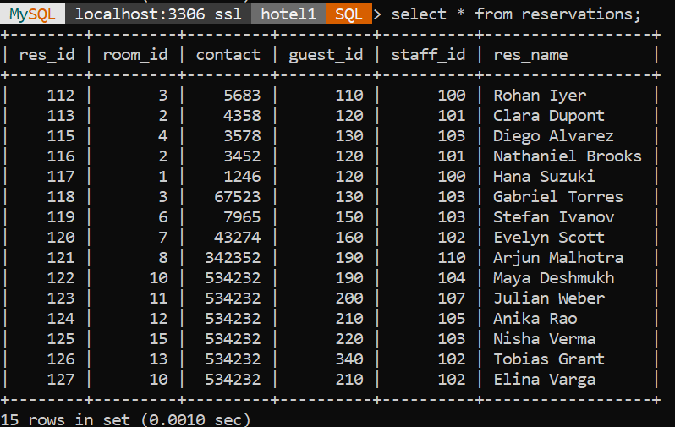
contents:
Reservations table
create table reservations (
res_id int primary key,
room_id int,
contact int
guest_id int
staff_id int
res_name varchar(255)
);

Slide 15
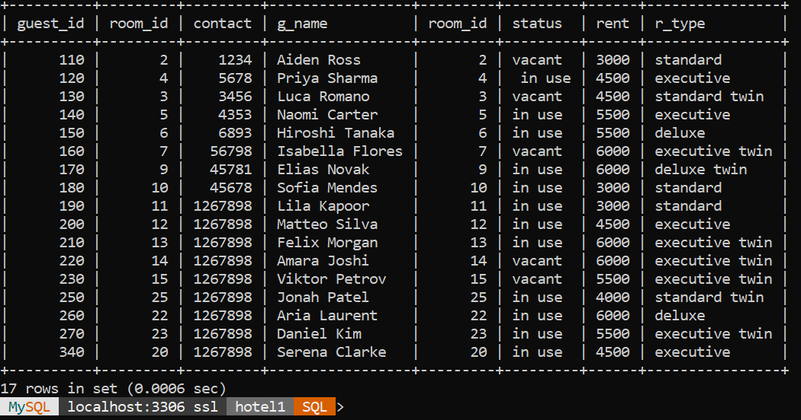
Joins 1: guests and rooms
Syntax:
-- joining guests to rooms
select * from guests g
inner join rooms r
on g.room_id = r.room_id;

Slide 16
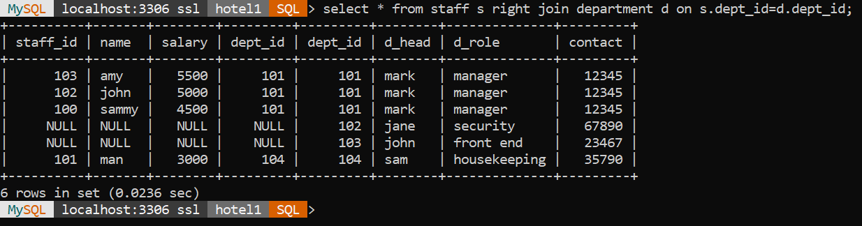
Joins 2:staff and department
-- joining staff to department
select * from staff s
right join department d
on s.dept_id = d.dept_id;

Slide 17
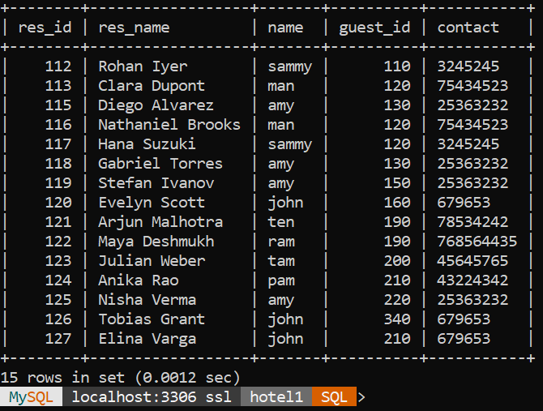
Joins 3:resrvations and staff
-- ( who handled the booking ? )
select r.res_id, g.guest_id, s.name
from reservations r
inner join guests g
on r.guest_id = g.guest_id
inner join staff s
on r.staff_id = s.staff_id;

Slide 18
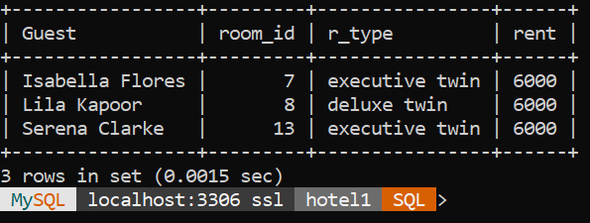
Subqueries 1:
--Who has the most expensive room?
SELECT g.g_name AS Guest, r.room_id, rm.r_type, rm.rent
FROM Guests g
JOIN Reservations r
ON g.guest_id = r.guest_id
JOIN Rooms rm
ON r.room_id = rm.room_id
WHERE rm.rent = ( SELECT MAX(rent) FROM Rooms);

Slide 19
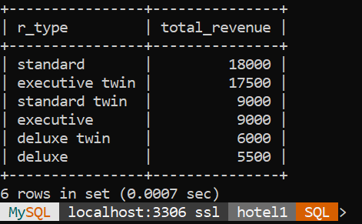
Subqueries 2:
-- revenue per room type
SELECT rm.r_type, SUM(rm.rent) AS total_revenue
FROM Reservations res
JOIN Rooms rm
ON res.room_id = rm.room_id
GROUP BY rm.r_type
ORDER BY total_revenue DESC;

Slide 20
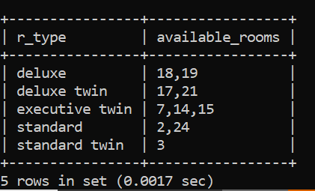
Subqueries 3:
-- Available rooms according to room type
SELECT r_type, GROUP_CONCAT(room_id) AS available_rooms
FROM Rooms
WHERE status = 'vacant’
GROUP BY r_type;

Slide 21
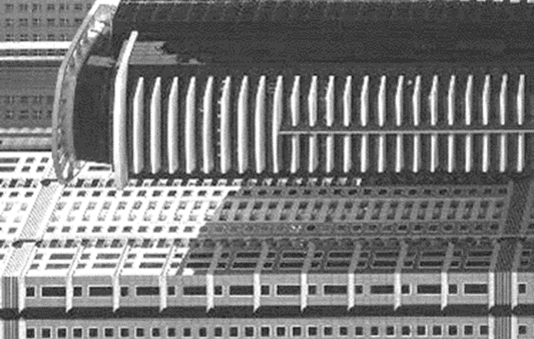
summary
The Hotel Management System project shows how MySQL databases can streamline hotel operations by organizing guests, bookings, staff, reservations and department data efficiently. Through the use of joins and subqueries, the system demonstrates the power of relational databases in providing quick, accurate, and connected information essential for smooth hotel management.

Slide 22
THANK YOU
Shivangi bhagurkar

